Slide 1


CMPE 180-92 Data Structures and Algorithms in C++ January 26 Class Meeting
Department of Computer Engineering San Jose State University Spring 2017 Instructor: Ron Mak
www.cs.sjsu.edu/~mak

Slide 2
Basic Info
Office hours
Th 2:30 – 4:30 PAM
ENG 250
Website
Faculty webpage: http://www.cs.sjsu.edu/~mak/
Class webpage: http://www.cs.sjsu.edu/~mak/CMPE180-92/
Green sheet
Assignments
Lecture notes

Slide 3
Permission Codes?
If you need a permission code to enroll in this class, complete the form at https://goo.gl/forms/Ayl0jablW5Ythquf1

Slide 4
Course Objectives
The primary goal of this class is to learn a useful subset of C++ programming language and fundamental data structures and algorithms expressed in C++.
You will learn best practices for developing software.
You will acquire software development skills that are valued by employers.

Slide 5
Course Objectives, cont’d
Not course objectives:
Complete knowledge of C++
We will briefly touch the new features of C++ 11 and 14.
Advanced data structures and algorithms
Advanced algorithm analysis

Slide 6
C++ Tutoring
We hope to provide C++ tutoring during the week by the instructional student assistants (ISAs).
Students found this very helpful last semester.
Tutors and their schedules to be announced.

Slide 7
Required Textbooks
Problem Solving with C++, 9th edition
Author: Walter Savitch
Publisher: Pearson, 2015
ISBN: 978-0133591743
Data Structures Using C++, 2nd edition
Author: D.S. Malik
Publisher: Cengage Learning, 2010
ISBN: 978-0324782011
You are responsible for doing the chapter readings before each class, as indicated in the class schedule.
In-class quizzes will be based on the readings.

Slide 8
Software to Install
Install one of the following integrated development environments (IDE) for C++ development on the Mac, Linux, or Windows platform:
Eclipse CDT (C/C++ Development Tooling): https://eclipse.org/cdt/
NetBeans C and C++ Development: https://netbeans.org/features/cpp/

Slide 9
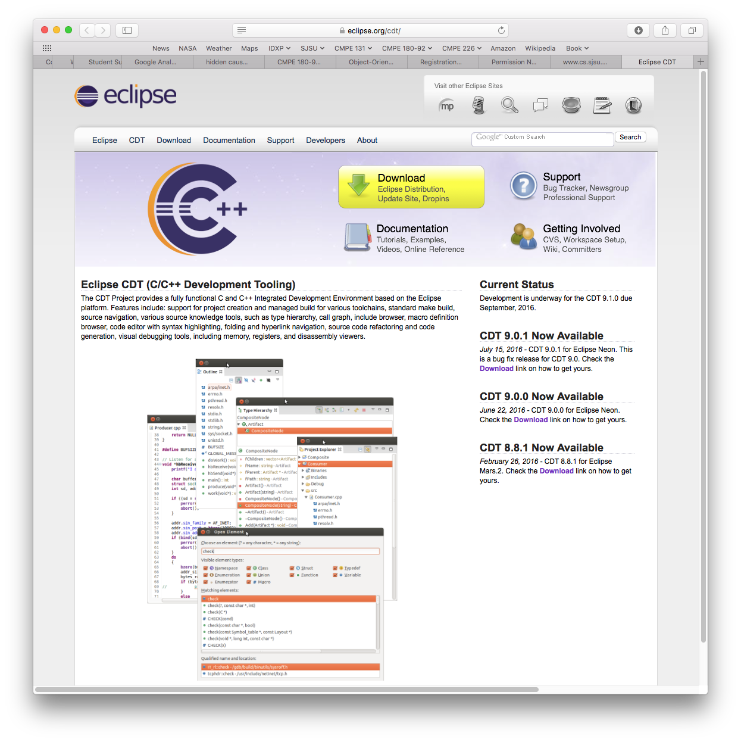
Software to Install, cont’d

Slide 10
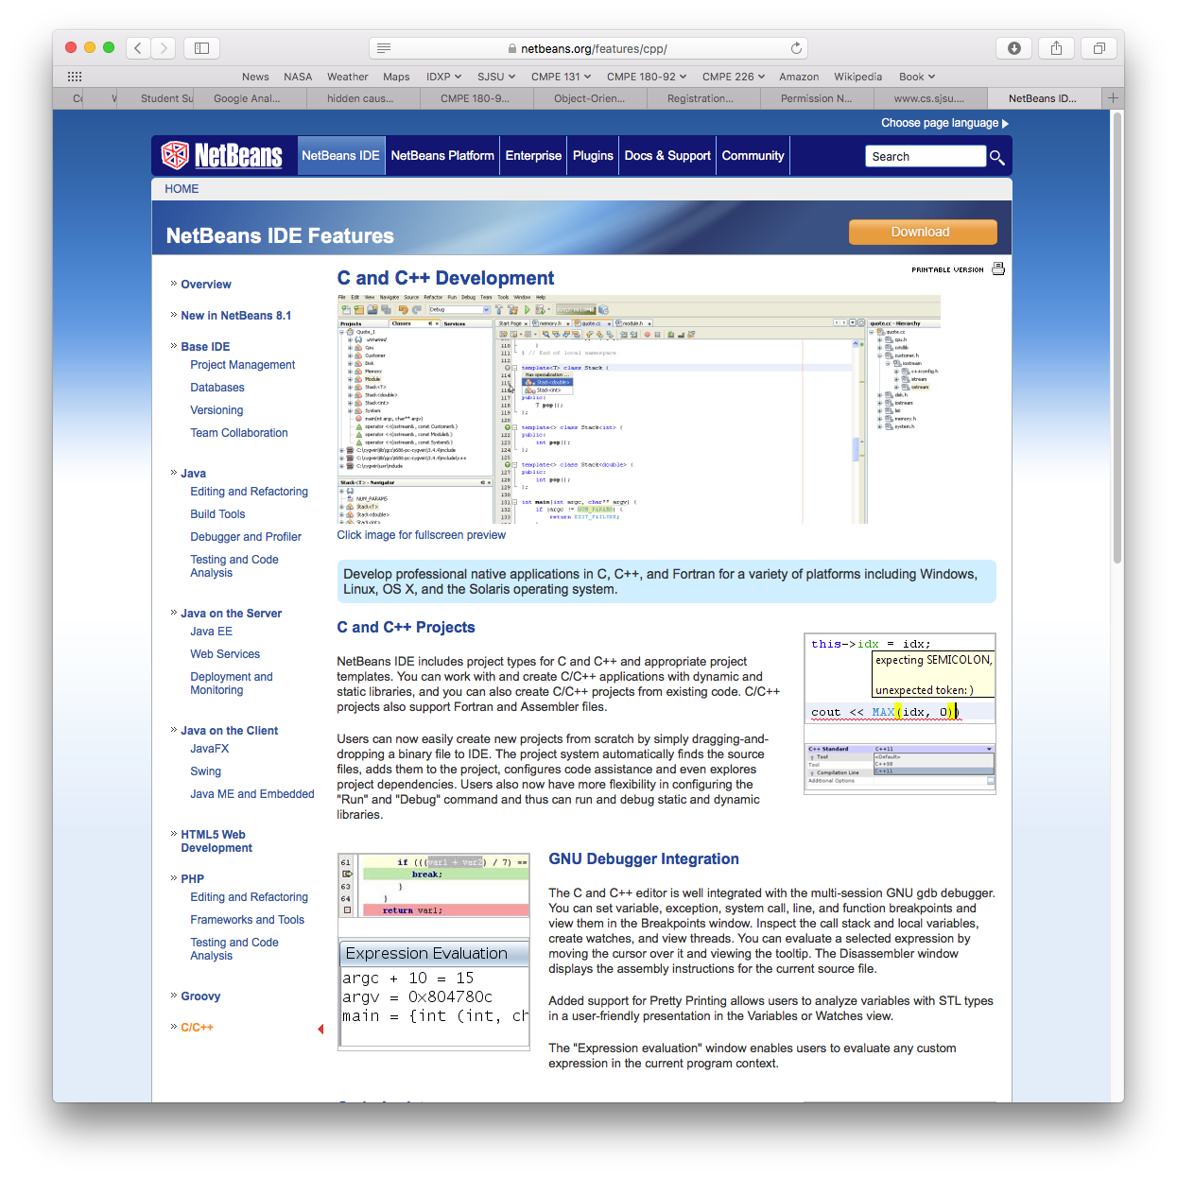
Software to Install, cont’d

Slide 11
C++ on the Mac and Linux Platforms
GNU C++ is usually pre-installed on the Mac and Linux platforms.
No further action required!
You can also use Apple's Xcode on the Mac, but then you run the risk of writing programs that will not port to other platforms.

Slide 12
C++ on Windows
You must first download and install GNU C++ via Cygwin.
Cygwin simulates a Linux development environment, including the bash command-line interpreter.
Helpful links:
http://web.cecs.pdx.edu/~pkwong/ECE103_files/Resources/Compiler/C_GNU/GCC_Installation/How_to_Install_Cygwin+GCC.htm on how to install Cygwin.
https://www.youtube.com/watch?v=i2h_976SpV0 on how to install Cygwin.
https://www.youtube.com/watch?v=5lJ6evIAndo on how to compile and run the Hello World program on Cygwin.

Slide 13
C++ on Windows, cont’d
Despite what the second video shows, do not use Notepad to edit your programs on Windows!
Download and install Eclipse or NetBeans and use the IDE to edit, compile, and run your programs.
If you want to compile and run on the command line, use the Cygwin terminal (there should be an icon on your desktop) and not the Windows terminal.
Do not install MinGW instead of Cygwin.
MinGW in a minimum C++ installation that lacks many of the POSIX libraries required by some of the assignments.
Microsoft Visual C++ is a portability risk.

Slide 14
C++ 2011 Standard
We will use the 2011 standard of C++.
You must set this standard explicitly for your project in Eclipse and in NetBeans.
On the command line:
g++ foo.cpp –std=c++11 –o foo

Slide 15
Set the C++ 2011 Standard in Eclipse
Right-click on your project in the project list at the left side of the window.
Select “Properties” from the drop-down context menu.
In the left side of the properties window, select “C/C++ Build” ➔ “Settings”.
In the Settings dialog, select “GCC C++ Compiler” ➔ “Dialect”.
For “Language standard” select “ISO C++ 11”.
Click the “Apply” button, answer “Yes”, and then click the “OK” button.

Slide 16
Set the C++ 2011 Standard in NetBeans
Right-click on your project in the project list at the left side of the window.
Select “Properties” from the drop-down context menu.
In the left side of the properties window, select “Build” ➔ “C++ Compiler”.
In the table, for “C++ Standard” select “C++11”.
Click the “Apply” button and then click the “OK” button.

Slide 17
Assignments
You will get lots of programming practice!
At least one programming assignment per week.
Each worth up to 100 points depending on difficulty.
We will use the online CodeCheck system which will automatically check your output against a master.
You will be provided the URL for each assignment.
You can submit as many times as necessary to get the correct output.

Slide 18
Assignments, cont’d
Assignments will be due the following week, before the next lecture.
Solutions will be discussed at the next lecture.
Assignments will not be accepted after solutions have been discussed in class.

Slide 19
Individual Work
You may study together.
You may discuss the assignments together.
But whatever you turn in must be your individual work.

Slide 20
Academic Integrity
Copying another student’s work or sharing your work is a violation of academic integrity.
Violations will result in harsh penalties by the university.
Academic probation.
Disqualified for TA positions in the university.
Lose internship and OPT sponsorship at local companies.
Instructors must report violations.

Slide 21
Moss
Department policy is for programming assignments to be run through Stanford University’s Moss application.
Measure of software similarity
Detects plagiarism
http://theory.stanford.edu/~aiken/moss/
Moss is not fooled by
Renaming variables and functions
Reformatting code
Re-ordering functions
Example Moss output:
http://www.cs.sjsu.edu/~mak/Moss/

Slide 22
Quizzes
In-class quizzes check your understanding of:
the required readings
the lectures
Quizzes will be conducted online using Canvas.
Each quiz will be open for only a very short time period, around 5 minutes.
There will be no make-up quizzes.

Slide 23
Exams
The quizzes, midterm, and final examinations will be closed book.
Instant messaging, e-mails, texting, tweeting, file sharing, or any other forms of communication with anyone else during the exams violates academic integrity.

Slide 24
Exams, cont’d
There can be no make-up midterm examination unless there is a documented medical emergency.
Make-up final examinations are available only under conditions dictated by University regulations.

Slide 25
Final Class Grade
50% assignments
15% quizzes
15% midterm
20% final exam
The class is graded CR/NC.
Students who have a weighted score above the passing threshold at the end of the semester will receive the CR grade.
We expect least 70% of students will pass.

Slide 26
Fast Pace!
This class will move forward at a fast pace.
Lectures will consist of:
New PowerPoint slides by the instructor
PowerPoint slides from the textbook publishers
Program examples and live demos
In-class quizzes
Questions, answers, and discussion
Lecture materials will be posted to the class webpage.

Slide 27
What is C++
An object-oriented programming (OOP) language.
Supports encapsulation, inheritance, polymorphism.
Based on the C language with added OOP features.
A complex language!
Lots of features.
Somewhat arcane syntax.

Slide 28
A Useful Subset of C++
We will only learn a useful subset of C++.
Very few people (not including your instructor) know all of the language.
Among professional C++ programmers, everybody knows a different subset, depending on experience, training, and application domains.
It will be easy to stumble accidentally into an obscure language feature.
We’ll have to figure out together what happened!

Slide 29
Our First C++ Program
The infamous “Hello, world!” program.
helloworld.cpp
#include <iostream>
using namespace std;
int main()
{
cout << "Hello, world!" << endl;
return 0;
}
~mak/CMPE180-92/programs: g++ -o helloworld helloworld.cpp
~mak/CMPE180-92/programs: ./helloworld
Hello, world!

Slide 30
Our First C++ Program, cont’d
Mac demos
command line
Eclipse
Windows 10 demos
command line
NetBeans

Slide 31
Algorithms and Program Design
Savitch_ch_01.ppt: slides 57– 60
Display 1.4
Compiling and Running a C++ Program
Display 1.5
Preparing a C++ Program for Running
Display 1.7
Program Design Process

Slide 32
Sample Program 1-8: Pods and Peas
Savitch_ch_01.ppt: slides 34 – 44
Sample program 1.8

Slide 33
Break

Slide 34
Identifiers, Variables, and Keywords
Identifiers are names.
Variables represent values that can change.
Variables have names (variable identifiers).
Declare variables before you use them.
A declaration can give an initial value to a variable.
Keywords are reserved by C++ and cannot be used as identifiers.
Examples: if for while

Slide 35
Assignment Statements
At run time, be sure to initialize a variable with a value before you use it.
Do not confuse = (assignment) with == (equality comparison).

Slide 36
Input and Output
Input stream
Data read by the program at run time.
Standard input stream: cin (default: the keyboard).
Extract: cin >> x >> y;
Output stream
Written by the program at run time.
Standard output stream: cout (default: the display).
Insert: cout << "x equals " << x << endl;

Slide 37
#include and using namespace
#include <iostream>
Read in the definitions of cin and cout.
using namespace std;
Make the names cin and cout that reside in the standard namespace std available to the program.

Slide 38
Formatting Real Numbers for Output
Call methods of cout to format real numbers.
cout.setf(ios::fixed);
Use fixed-point notation (not scientific).
cout.setf(ios::showpoint);
Always show the decimal point.
cout.precision(2);
How many decimal places.

Slide 39
Input From cin
cin >> v1 >> v2 >> v3;
Read values into multiple variables.
The values should be separated by spaces.
The values are not read until you press the return key.
Therefore, you can backspace and make corrections.

Slide 40
Some Basic Data Types
A data type determines
what kind of data values
what operations are allowed
Data type int for integer values without decimal points.
Examples: 0 2 45 -64
Data type short for small integer values.
Data type long for very large integer values.

Slide 41
Some Basic Data Types, cont’d
Data type double for real numbers.
Fixed-point notation: 34.1 23.0034 -1.0 89.9
Scientific notation: 3.67e17 5.89E-6 -7.23e+12
Data type float for less precision and smaller magnitude.
Data type char for individual characters.
Examples: 'a' 'Z'
Use only single quotes for character constants in a program.

Slide 42
Some Basic Data Types, cont’d
Data type bool for the Boolean values true and false.
The Boolean value false is stored as the integer 0.
The Boolean value true is stored as the integer 1.

Slide 43
cin Skips Input Blanks
The statements when given the input will set ch1 to 'A' and ch2 to 'B'.
cin uses blanks and line feeds to separate input data values, but otherwise the blanks and line feeds are skipped.
char ch1, ch2;
cin >> ch1 >> ch2;
A B

Slide 44
String Type
#include <string>
Required if your program uses strings.
Enclose string values with double quotes in your program.
Example: "Hello, world!"
To input a string from cin that includes spaces, all in one line:
string str;
getline(cin, str);

Slide 45
Type Compatibilities and Conversions
int pi = 3.14;
double → int is invalid. You cannot set a double value into an int variable .
Some valid conversions:
int → double
char → int
int → char
bool → int
int → bool
Any nonzero integer value is stored as true.
Zero is stored as false.

Slide 46
Arithmetic
Arithmetic operators: + - * / %
Integer / result if both operands are integer.
Quotient only.
Use the modulo operator % to get a remainder.
Double / result (includes fractional part) if either or both operands are double.

Slide 47
Operator Shorthand
n += 5 shorthand for n = n + 5
n -= 5 shorthand for n = n - 5
n *= 5 shorthand for n = n*5
n /= 5 shorthand for n = n/5
n %= 5 shorthand for n = n%5

Slide 48
The if Statement
Example if statement:
Example if else statement:
if (n <= 0)
{
cout << "Please enter a positive number." << endl;
}
if (hours > 40)
{
gross_pay = rate*40 + 1.5*rate*(hours - 40);
}
else
{
gross_pay = rate*hours;
}

Slide 49
while Loops
Example while loop:
Example do while loop:
while (count_down > 0)
{
cout << "Hello ";
count_down = count_down - 1;
}
do
{
cout << "Hello ";
count_down = count_down - 1;
}
while (count_down > 0)

Slide 50
Named Constants
Good programming practice to give names to constants:
Easier for humans to read the program.
Easier to modify the program.
Convention: Use ALL_CAPS for the names of constants.
const double PI = 3.1415626;

Slide 51
Boolean Operators
Relational operators: == != < <= > >=
And: &&
Or: ||
Not: !
Short-circuit operation: p && q
q is not evaluated if p is false
Short-circuit operation: p || q
q is not evaluated if p is true

Slide 52
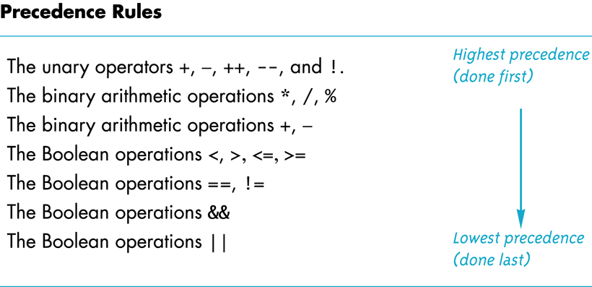
Precedence Rules
Savitch_ch_02.ppt: slide 101

Slide 53
Enumeration Types
A data type with values defined by a list of constants of type int
Examples:
enum Direction {NORTH, SOUTH, EAST, WEST};
enum MonthLength{JAN_LENGTH = 31, FEB_LENGTH = 28, MAR_LENGTH = 31, … DEC_LENGTH = 31};

Slide 54
Nested if Statements
Example:
if (net_income <= 15000)
{
tax_bill = 0;
}
else if ((net_income > 15000) && (net_income <= 25000))
{
tax_bill = (0.05*(net_income - 15000));
}
else // net_income > $25,000
{
five_percent_tax = 0.05*10000;
ten_percent_tax = 0.10*(net_income - 25000);
tax_bill = (five_percent_tax + ten_percent_tax);
}

Slide 55
The switch Statement
Use a switch statement instead of nested if statements to compare a single integer value for equality.
Note the need for the break statements.
Note the default case at the bottom.
int digit;
...
switch(digit)
{
case 1: digit_name = "one"; break;
case 2: digit_name = "two"; break;
case 3: digit_name = "three"; break;
case 4: digit_name = "four"; break;
case 5: digit_name = "five"; break;
case 6: digit_name = "six"; break;
case 7: digit_name = "seven"; break;
case 8: digit_name = "eight"; break;
case 9: digit_name = "nine"; break;
default: digit_name = ""; break;
}

Slide 56
The Increment and Decrement Operators
++n
Increase the value of n by 1.
Use the increased value.
n++
Increase the value of n by 1.
Use the value before the increase.

Slide 57
The Increment and Decrement Operators, cont’d
--n
Decrease the value of n by 1.
Use the decreased value.
n--
Decrease the value of n by 1.
Use the value before the decrease.

Slide 58
for Loops
Example:
int sum = 0;
for (int n = 1; n <= 10; n++)
{
sum = sum + n;
}
cout << "The sum of the numbers 1 to 10 is "
<< sum << endl;
Note that variable n
is local to the loop body.

Slide 59
for Loops, cont’d
The for loop uses the same components as the while loop, but in a more compact form.
for (n = 1; n <= 10; n++)
Initialization Action
Update Action
Boolean Expression

Slide 60
The break Statement
Use the break statement to exit a loop before “normal” termination.
Do not overuse! Well-designed loops should end normally.
This use of break is different from the necessary use of break in a switch statement.

Slide 61
Loop Considerations
Choosing the right kind of loop to use
Designing loops
How to control a loop
How to exit from a loop
Nested loops
Debugging loops

Slide 62
Assignment for Week 1
Assignment #1 will give you practice with C++ control statements and simple text I/O.
Write-up: http://www.cs.sjsu.edu/~mak/CMPE180-92/assignments/1/Assignment1.pdf
Input file: http://www.cs.sjsu.edu/~mak/CMPE180-92/assignments/1/presidents.in
CodeCheck URL: http://codecheck.it/codecheck/files/1701170532e3jbdmmyqrkasoot12cf0x03k
Follow carefully the instructions on how to use CodeCheck and how to submit into Canvas.

